Slide 1

Environment & Ecology
Unit-IV
Environmental quality standards and instrumental techniques for monitoring of pollutants (10 hrs)
Department of Chemistry
National Institute of Technology Raipur
Raipur-492010, Chhattisgarh
India

Slide 2
SYLLABUS
Lecture 1: Ambient air quality standards & water quality parameter and standards
Lecture 2: Discussion and determination of pH and turbidity of water
Lecture 3: Hardness of water and it’s determination by complexometric titration
Lecture 4: Basic principles of spectroscopy and quantitative determination of sulphate by using UV-Vis. Spectroscopic method
Lecture 5: Quantitative determination of phosphate and iron by using UV-Vis. Spectroscopic method
Lecture 6: Dissolved oxygen (D.O.) and it’s determination by Winkler’s Method
Lecture 7: Discussion and determination of biochemical oxygen demand (BOD) and chemical oxygen demand (COD)
Description about some advanced instrumental techniques used in environmental pollution monitoring:-
Lecture 8: UV-Visible spectroscopy, calibration and traceability
Lecture 9: Atomic Absorption Spectroscopy (AAS)
Lecture 10: Nephelometry and Turbidimetry

Slide 3
Lecture 1
Air quality standards: An air quality standard is a description of a level of air quality that is adopted by a regulatory authority as enforceable. Air quality standards are legal limits placed on the levels of air pollutants in the ambient air during a given period of time. It provide a legal framework for air pollution control.
Under the authority of the Air (Prevention and Control of Pollution) Act of 1981, India’s Central Pollution Control Board (CPCB, New Delhi) sets national ambient air quality standards and is responsible for both testing air quality and assisting governments in planning to meet such standards. State Pollution Control Boards are permitted to set stricter standards than those in effect nationally.
Ambient air quality refers to the condition or quality of air surrounding us in the outdoors.
Different countries have their own air quality indices, corresponding to different national air quality standards. World Health Organization (WHO, Geneva, Switzerland) and Environment Protection Agency (EPA, Washington, D.C., United States) are two international bodies to set the standards internationally.

Slide 4
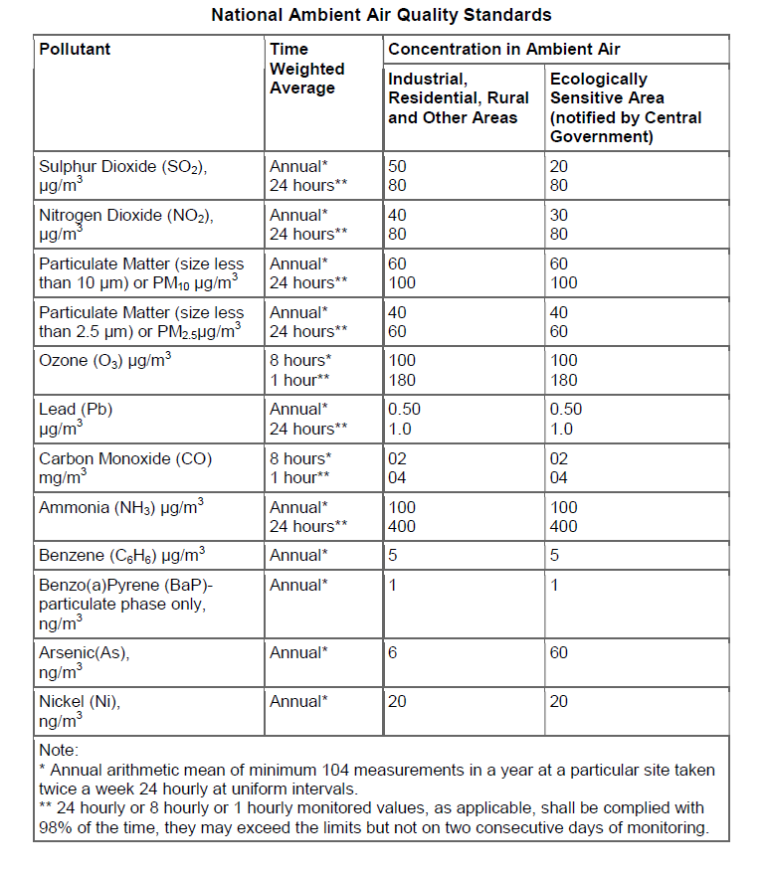
Indian air quality standards based on CPCB report 2017 are listed below:-
http://www.indiaenvironmentportal.org.in/files/file/Permissible%20Level%20for%20Pollutants.pdf

Slide 5
Water quality parameter and standards
For any water body to function adequately in satisfying the desired use, it must have corresponding degree of purity. Drinking water should be of highest purity. As the magnitude of demand for water is fast approaching the available supply, the concept of management of the quality of water is becoming as important as its quantity.
Each water use has specific quality need. Therefore, to set the standard for the desire quality of a water body, it is essential to identify the uses of water in that water body. In India, the Central Pollution Control Board (CPCB) has developed a concept of designated best use. According to this, out of the several uses of water of a particular body, the use which demands highest quality is termed its designated best use. Five designated best uses have been identified. This classification helps the water quality managers and planners to set water quality targets and design suitable restoration programs for various water bodies.

Slide 6
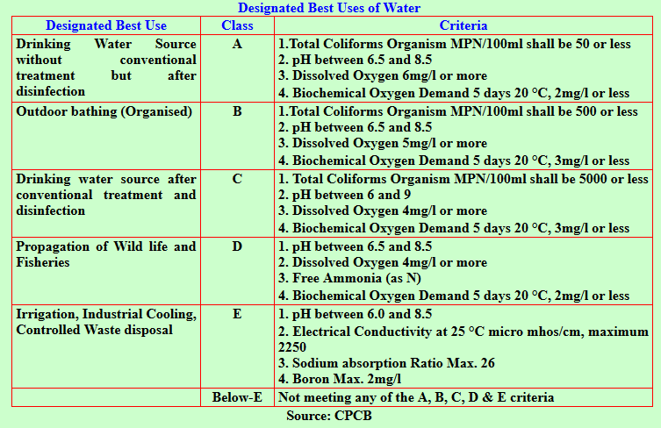
http://117.252.14.242/rbis/india_information/water%20quality%20standards.htm

Slide 7
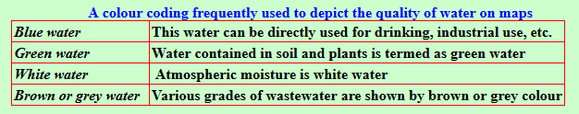
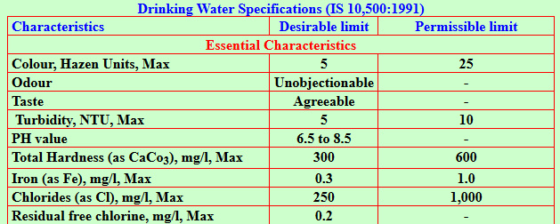
Hazen Colour Scale: Nowadays, the colour scale used for measuring water quality can also be referred to as the Pt-Co (Platinum-Cobalt) / APHA (from American Public Health Association) / HU (Hazen Units) colour scale. It ranges from 0 (clean or distilled water) to 500 (very dark, polluted water).
http://117.252.14.242/rbis/india_information/water%20quality%20standards.htm

Slide 8
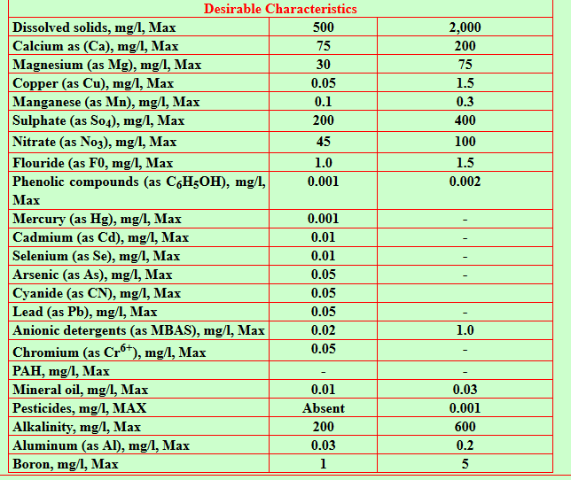
http://117.252.14.242/rbis/india_information/water%20quality%20standards.htm

Slide 9
Lecture 2
Determination of pH
Introduction: The term pH refers to the measure of hydrogen ion concentration in a solution and defined as the negative log of H⁺ ions concentration in water and wastewater. The values of pH 0 to a little less than 7 are termed as acidic and the values of pH a little above 7 to 14 are termed as basic. When the concentration of H⁺ and OH– ions are equal then it is termed as neutral (pH=7).
Environmental Significance: Lower value of pH below 4 will produce sour taste and higher value above 8.5 a bitter taste. Higher values of pH hasten the scale formation in water heating apparatus and also reduce the germicidal potential of chlorine. High pH induces the formation of halo hydrocarbons, which are causing cancer in human beings. Determination of pH is one of the important objectives in biological/secondary treatment of the wastewater. In anaerobic treatment, if the pH goes below 5 due to excess accumulation of acids, the process is severely affected. Shifting of pH beyond 5 to 10 upsets the aerobic treatment of the wastewater.

Slide 10
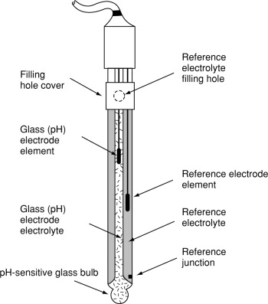
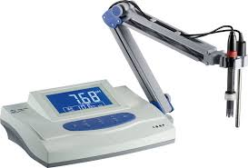
Principle/Theory: The pH electrode used in the pH measurement is a combined glass electrode. It consists of sensing half cell and reference half cell, together form an electrode system. The sensing half cell is a thin pH sensitive semi permeable membrane, separating two solutions, viz., the outer solution, the sample to be analyzed and the internal solution, enclosed inside the glass membrane and has a known pH value. An electrical potential is developed inside and another electrical potential is developed outside, the difference in the potential is measured and is given as the pH of the sample.
Glass Electrode
Temp. Sensor
pH-Meter
Glass Electrode

Slide 11
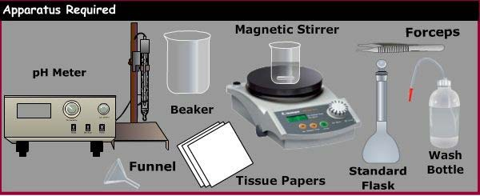
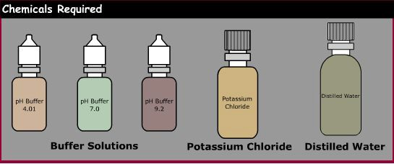
Materials/Apparatus Required
Apparatus: pH meter, Standard flasks, Magnetic Stirrer, Funnel, Beaker, Wash Bottle, Tissue Paper, Forceps, etc.
Chemicals: Buffers Solutions of pH 4.0, 7.0 and 9.2, Potassium Chloride, Distilled Water, etc.
Procedure: There are three major steps in experiment i.e. (i) Reagent preparation for calibration, (ii) Calibration of pH-meter, and (iii) Testing of unknown water sample
Preparation of buffer solutions of pH 4.0, 7.0, and 9.2: Take three 100 mL measuring flasks and separately in each flask add buffer tablets of required pH (i.e. pH 4.0, 7.0, and 9.2), then dissolve the tablet and make up the volume upto the mark.
Calibration of pH-meter: By using calibration knob, one can calibrate instrument by dipping electrode into buffer solution of pH 7.0 first, then into 9.2 or 4.0.

Slide 12
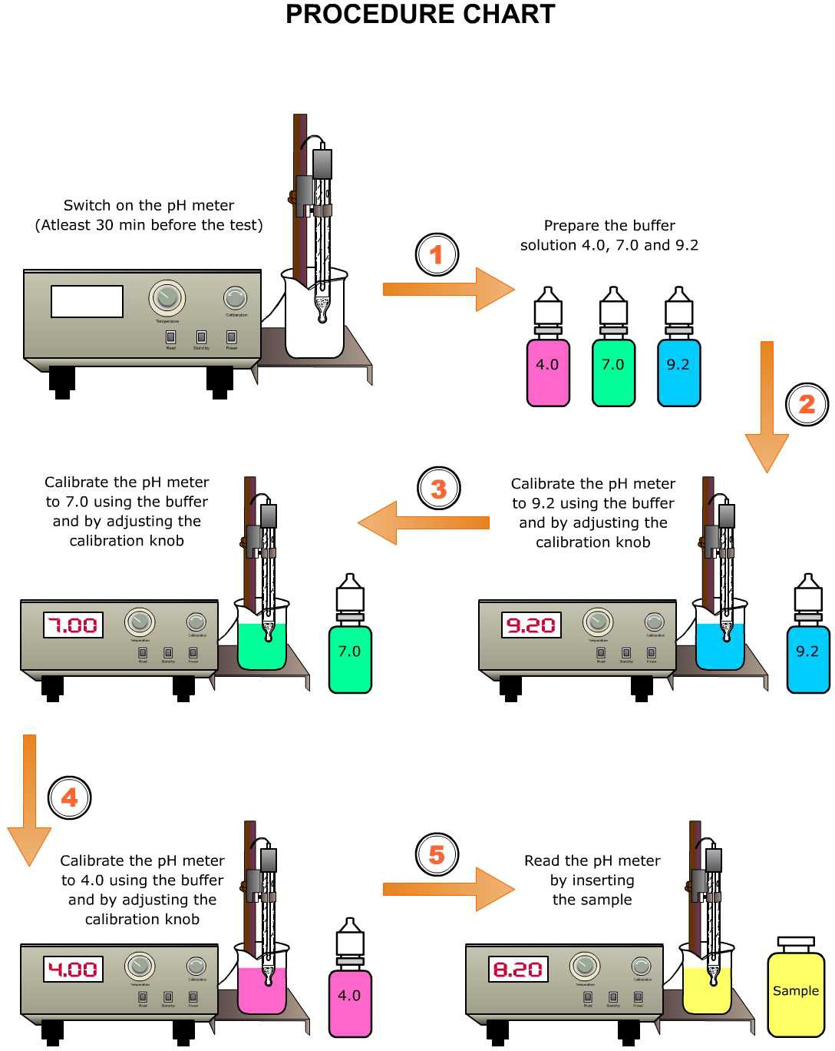
(iii) Testing of unknown water samples: In a clean dry 100 mL beaker, take the water sample (about 50mL), then place the electrode in the beaker containing the water sample, wait until you get a stable reading, then record the reading of pH meter.
Remove the electrode from the water sample, wash it with distilled water and then wipe gently with soft tissue before the measurement of next sample.
Schematic representation of procedure are given below:

Slide 13
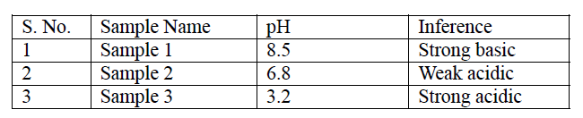
Observation Table: Record the pH of water samples and results are tabulated in observation table. A typical observation table is given below:-
Title: pH of given water samples
Results: pH of given water samples are……………………………………….
Determination of Turbidity
Turbidity is the measure of relative clarity of a liquid. Turbidity makes water cloudy or opaque. It is an optical characteristic of water and is a measurement of the amount of light that is scattered by material in the water. Material that causes water to be turbid include clay, silt, very tiny inorganic and organic matter, algae, dissolved colored organic compounds, and plankton and other microscopic organisms. Turbidity of water have various environmental and health issues. Turbidity of water can be determined by using Nephelometer and Turbidimeter. Both instruments work on basic property of light i.e. scattering. Details about Nephelometry & Turbidimetry will be discuss in lecture 10.

Slide 14
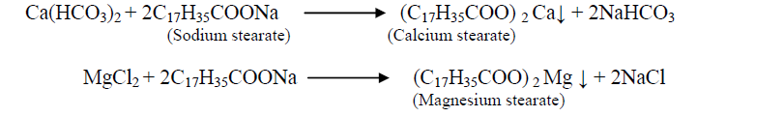
Lecture 3
Hardness and it’s determination by complexometric titration
Introduction: Hardness is the characteristic of water which prevents leathering with soap. It arises due to presence of harness producing substances such as carbonate, bicarbonate, chloride and sulphate salts of Calcium, Magnesium, Iron, Aluminium and other heavy metals. Water containing hardness in terms of calcium carbonate at concentrations below 60 ppm is generally considered as soft; 60–120 ppm, moderately hard; 120–180 ppm, hard; and more than 180 ppm, very hard. These salts when reacts with soap cause white precipitation instead of forming leather.
Generally there are two types of hardness in water i.e. temporary hardness and permanent hardness.
Temporary Hardness: Temporary hardness is caused by the presence of bicarbonate salts, which can be removed simply by boiling of water.
Permanent Hardness: Permanent hardness arises mainly due to chloride and sulphate salts which cannot remove by boiling.

Slide 15
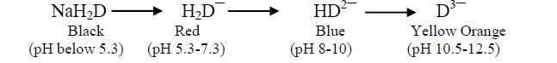
Environmental Significance: Natural sources of water generally contain calcium concentrations up to and exceeding 100 ppm while magnesium is present usually at lower concentrations (from negligible to about 50 ppm and rarely above 100 ppm). Thus, calcium-based hardness usually predominates.
Both calcium and magnesium are essential minerals and beneficial to human health in several respects. Inadequate intake of either nutrient can result in adverse health consequences. Recommended daily intakes of each element have been set at national and international levels. Individuals vary considerably in their needs for and consumption of these elements.
Principle/Theory: Determination of hardness is important for industrial purpose mainly, because it forms scale and sludge inside the boilers and pipelines which reduces the capacity and efficiency of the boiler. In present experiment hardness of water sample is determined by EDTA-titration method. In this method different soluble complex such as M-EBT and M-EDTA are formed hence it is also called as complexometric titration method. Disodium salt of EDTA is used during solution preparation as its solubility is better than pure EDTA. pH of the reaction mixture is maintain at 8-10 using ammonical buffer solution.

Slide 16
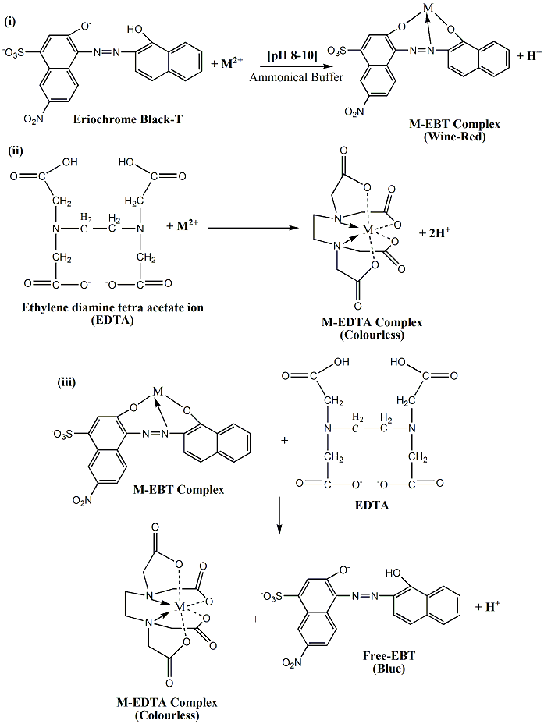
When indicator is added in water sample at pH 8-10, it reacts with Ca and Mg ions present in water and forms M-indicator complex of wine red colour. During titration EDTA first reacts with remaining Ca and Mg ions in water and forms M-EDTA complex which is colourless. When EDTA reacts with all the Ca and Mg ions it attacks on the M-indicator complex and make the indicator free. Free-EBT appears as blue colour at end point.

Slide 17
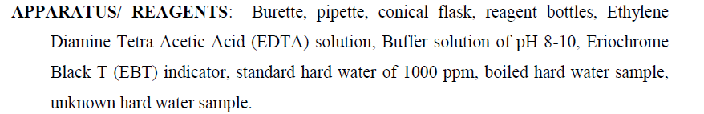
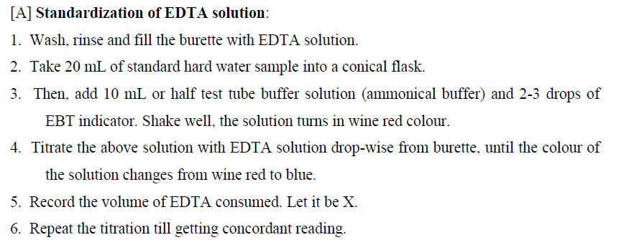
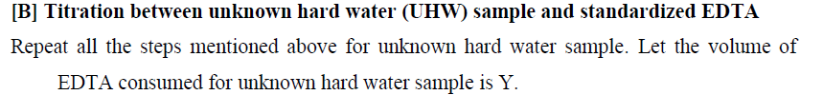
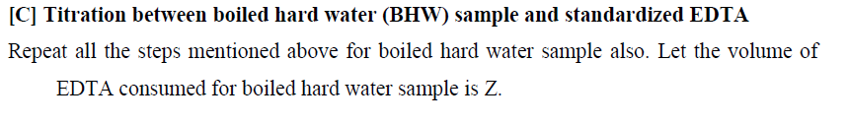
Procedure

Slide 18
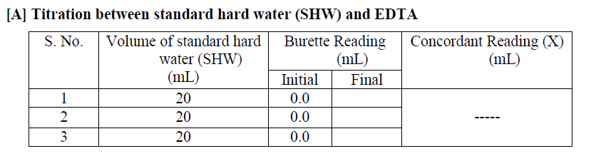
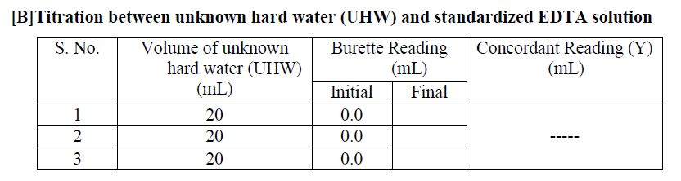
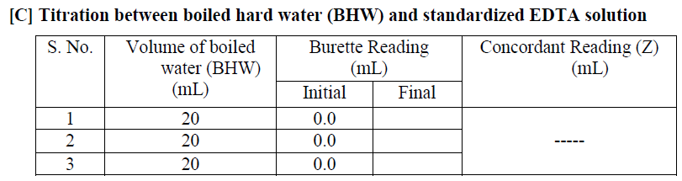
Observation Table

Slide 19
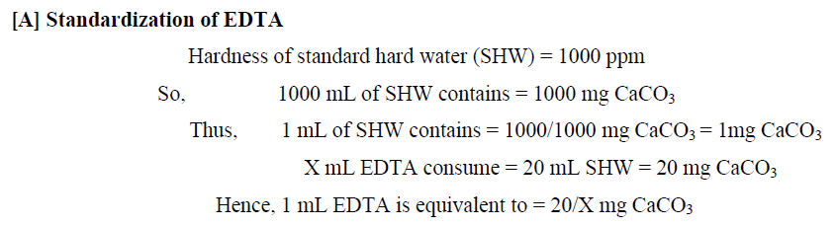
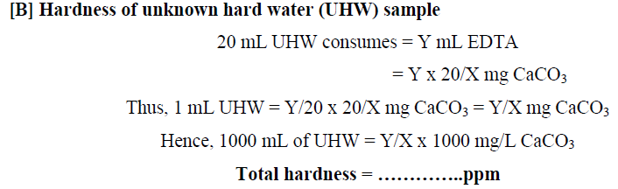
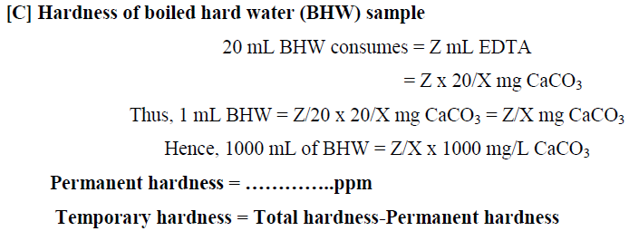
Calculation

Slide 20
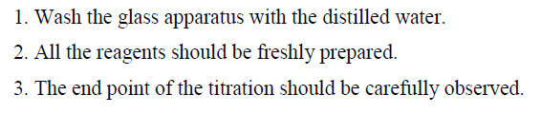
Result
Hardness of given water sample is-
Total hardness = …………….ppm
Permanent hardness = ………ppm
Temporary hardness = ………ppm
Precautions

Slide 21
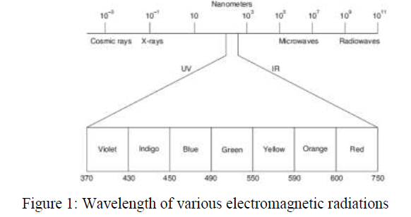
Lecture 4
Fundamental aspects of spectroscopy
Spectroscopy is advance instrumental technique that is used to determine the quality as well as quantity of any unknown sample. It is defined as the branch of science which deals the study of interaction between matter and electromagnetic radiations. Basically, electromagnetic (EM) radiation is the form of energy. Like sun light, there are various forms of electromagnetic radiations such as cosmic rays, X-rays, ultra-violet, visible, infra-red, microwave, and radio waves (Figure 1). The arrangement of all types of electromagnetic radiations in order of their increasing wavelengths or decreasing frequencies is known as complete electromagnetic spectrum.

Slide 22
If electromagnetic radiation is passed through a matter, then some of the wavelengths are absorbed while others remains unaffected. Any wavelength of light that a particular molecule will absorb will be due to changes in electronic, vibrational or rotational energy levels permissible for its atoms. The amount wavelength absorbed is measured with the help of spectrometer/spectrophotometer.
The study of spectroscopy deals with emission as well as absorption spectra. An emission spectrum is produced by the emission of radiant energy by an excited molecule/atom. The excitation of atoms can be brought about thermally or electrically. While if electromagnetic radiations of certain wavelengths are passed through the substance under examination for some time, and then radiations of certain wavelengths are absorbed by the substance.
Resultant dark pattern of lines which correspond to the wavelengths absorbed is called absorption spectrum. With reference to specific range of electromagnetic radiations absorption spectroscopy is further named as UV-Vis spectroscopy, Infra-red spectroscopy, Microwaves spectroscopy (ESR), and Radiowave spectroscopy (NMR).

Slide 23
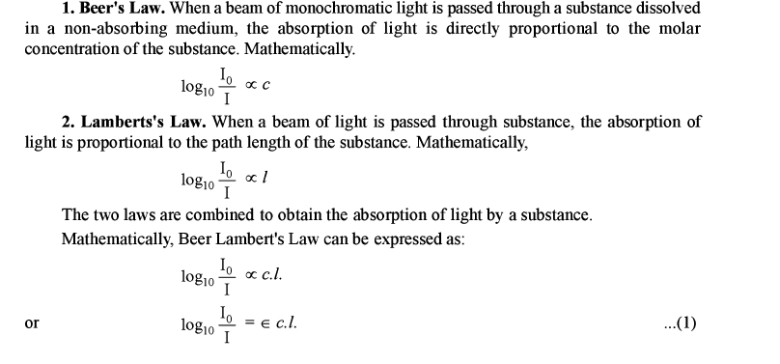
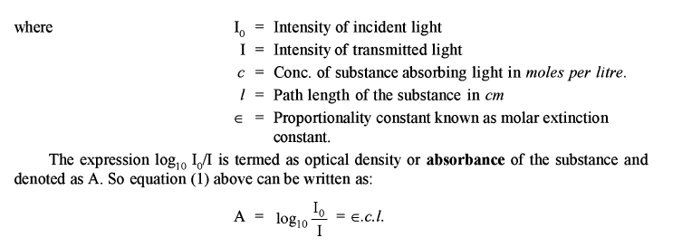
Absorption Laws: Spectroscopy works on the laws governing absorption of light by a substance. Two major laws which govern the absorption of light are given below:
Thus, Lambert-Beer’s Law is A = ε.c.l

Slide 24
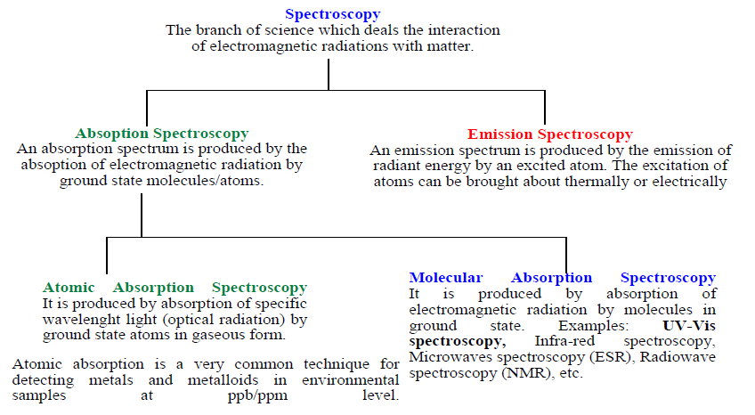
A conceptual diagram to clear the facts behind spectroscopy is given below:
Detail about UV-Vis. Spectroscopy are discussed in Lecture 8

Slide 25
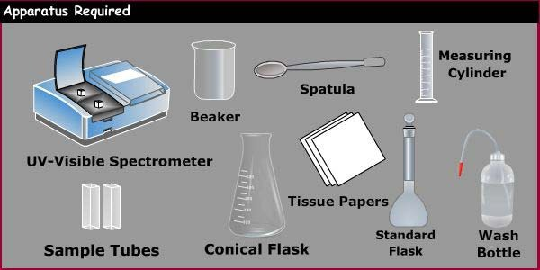
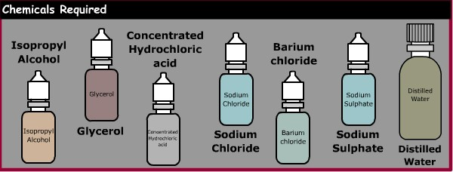
Determination of sulphate by UV-Vis. Spectroscopy
Introduction: Sulphates is widely distributed in nature and may be present in natural waters in concentration ranging from few hundred to several thousand mg/L. Sulphates occur naturally in numerous minerals. These dissolved minerals contribute to the mineral content of drinking-waters.
Principles: The turbidimetric method of measuring sulphates is based upon the fact that barium sulphates tends to precipitate in a colloidal form of uniform size and that this tendency is enhanced in presence of a sodium chloride, hydrochloric acid and glycerol.
SO₄²⁻ + BaCl₂ BaSO₄ Max. Wavelength = 420 nm
The absorbance of the barium sulphates formed is measured by a spectrophotometer at 420 nm and the sulphates ion concentration is determined by comparison of the reading with a standard curve.
Materials/Apparatus Required

Slide 26
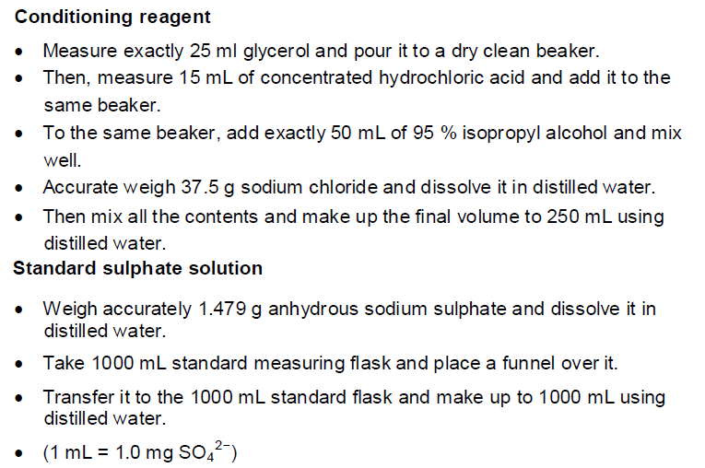
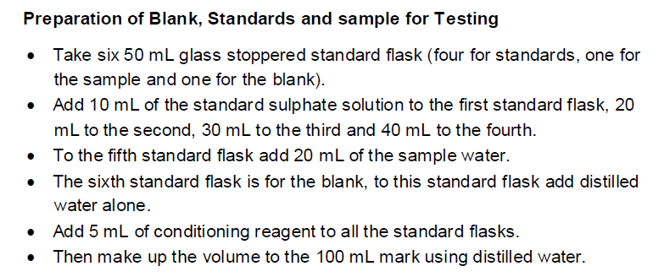
Procedure
Preparation of Reagents

Slide 27
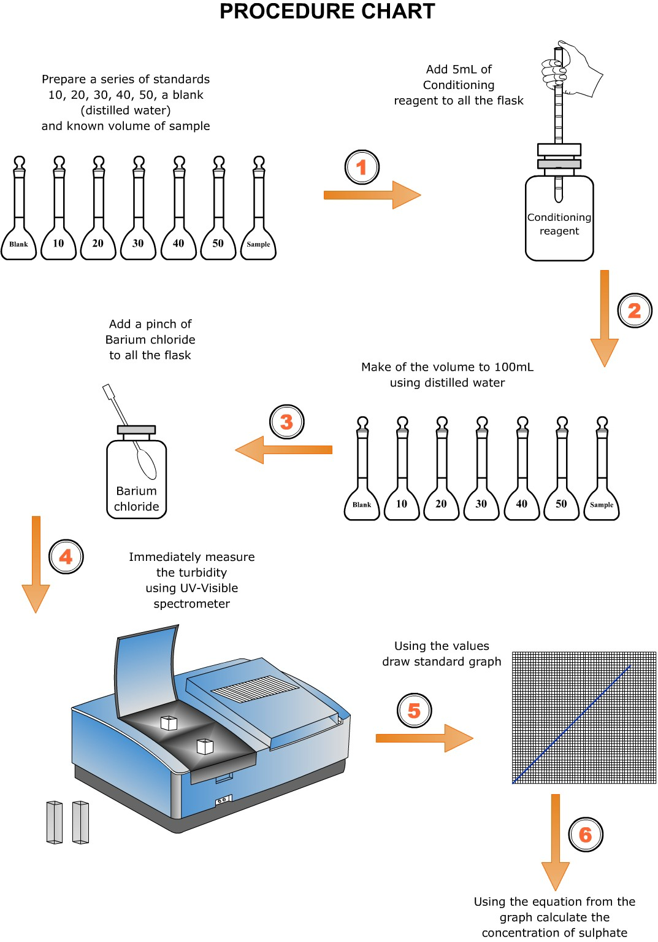
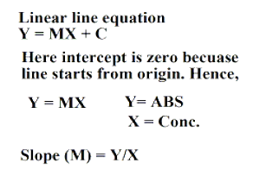
Procedure Chart
λmax = 420 nm
Absorbance
Concentration
Result: Given water sample contain sulphate ……..ppm.

Slide 28
Lecture 5
Determination of Iron by 1,10-phenanthroline method
Introduction: Iron occurs in the minerals and leaches to natural water bodies. Elevated iron contents/levels in water can cause stains in plumbing, laundry, cooking utensils, and can impart objectionable taste and colour to food materials. US EPA (United State Environmental Protection Agency) and BIS (Bureau of Indian Standards) approved the iron contents for drinking water i.e. 0.3 ppm.
Principles/Theory: Iron(II) reacts with 1,10-phenanthroline (ortho-phenanthroline) to form an orange-red complex {Ferrous ortho-phenanthroline-[(C₁₂H₈N₂)₃Fe]²⁺} which shows maximum absorbance at wavelength (λ_{max}) 510 nm. The colour intensity is independent of the acidity in the pH range 2-9, and is stable for long periods. First, all the iron(III) contents may be reduced with hydroxylamine solution to iron(II).

Slide 29
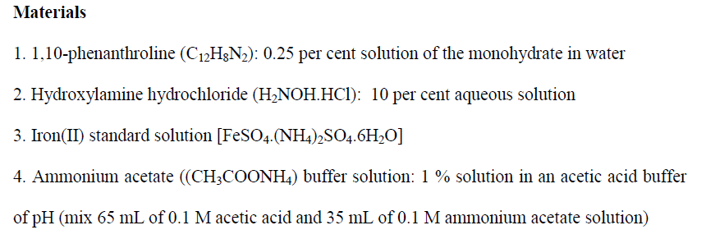
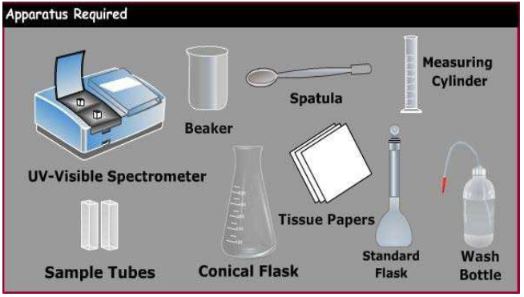
Materials/Apparatus Required

Slide 30
Procedure
1. Using a burette, transfer requisite volume of stock iron solution into separate 100 mL volumetric flasks to prepare 10, 20, 30, 40, and 50 ppm solution. Fill each flask about half full with deionized or distilled water.
2. Add 2mL of conc. HCl solution and 1 mL hydroxylamine solution to each flask, then heat upto boiling to convert all Fe(III) into Fe(II), then cool it.
3. Add 10.0 mL of the ammonium acetate buffer solution to each flask and mix properly.
4. Finally, add 4.0 mL of the 1,10-phenanthroline solution to each flask. Fill each flask to the 100 mL mark with distill water.
5. Mix thoroughly and wait for few moments to complete colour development.
6. Similarly blank solution can be prepare: add 10.0 mL of buffer, 2.0 mL of hydroxylamine hydrochloride solution, and 4.0 mL of 1,10-phenanthroline solution to a 100 mL flask. Dilute to the mark with distilled or deionized water and mix. This is your blank solution.
7. You now have five standard iron solutions and one blank. Record the absorbance of all standard and blank solution by UV-Vis spectrophotometer at λ_{max} 510.
8. Plot the calibration curve between iron concentration v/s absorbance. By using the plot and linear line equation (y = mx + c) conversion factor to convert absorbance to concentration can be obtained.
9. Same procedure applied with unknown water sample containing iron and records their absorbance.
10. By correlating with calibration graph, one can calculate iron concentration from unknown water sample.

Slide 31
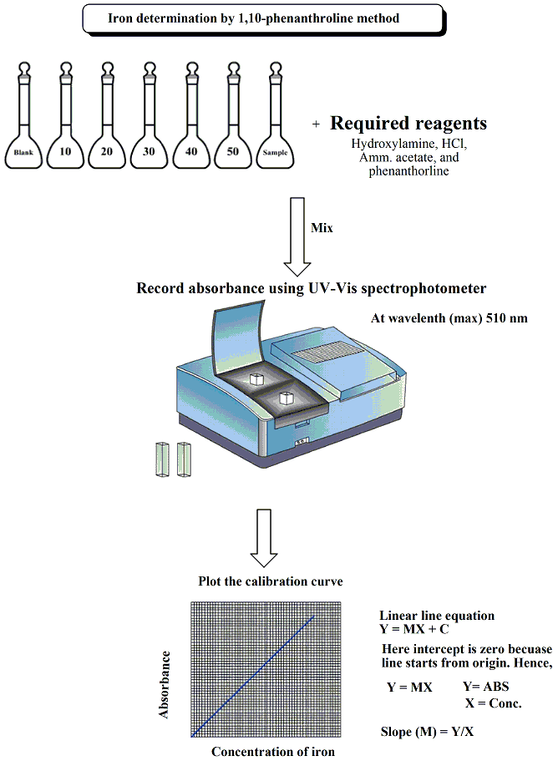
Procedure Chart
Result: Given water sample contain iron…………ppm.

Slide 32
Determination of Phosphate (PO₄³⁻)
Introduction
Phosphorus is an important nutrient that occurs widely in the environment. It is the key elements necessary for the growth of plants and animals. It is the eleventh most abundant element on the surface of the earth and is most commonly found as phosphate.
Phosphorus is a pre-requisite for microbial growth in the aqueous bodies. The increased concentration of phosphate is the key factor for the eutrophication of surface water. Heavy algal growth occurs when phosphate is present in water and as such is undesirable. Rainfall can cause varying amounts of phosphates to wash from farm soils into nearby waterways.
Phosphate will stimulate the growth of plankton and aquatic plants which provide food for fish. This may cause an increase in the fish population and improve the overall water quality. However, if an excess of phosphate enters the waterway, algae, and aquatic plants will grow wildly, choke up the waterway and use up large amounts of oxygen. This condition is known as eutrophication or over-fertilization of receiving waters. This rapid growth of aquatic vegetation eventually dies and as it decays it uses up oxygen. This process in turn causes the death of aquatic life because of the lowering of dissolved oxygen levels.
Phosphates are not toxic to people or animals unless they are present in very high levels. Digestive problems could occur from extremely high levels of phosphate. Thus, the determination of phosphorus is important to water analyst.

Slide 33
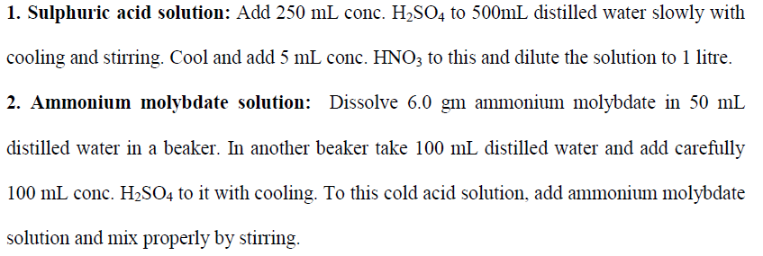
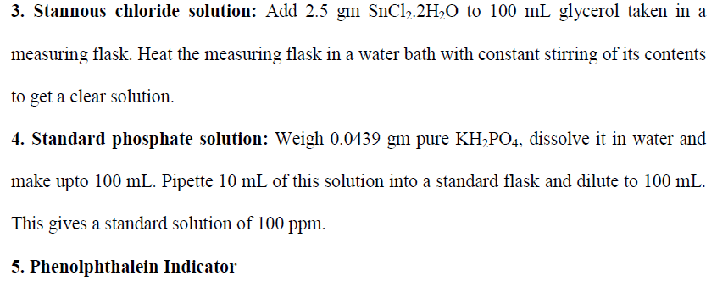
Materials/Apparatus Required

Slide 34
Theory/Principles
Phosphate contents of water can be measured quantitatively by UV-Vis. Spectrophotometer. Phosphate ion combines with amm. molybdate under acidic condition to form a blue colour complex known as ammonium phosphomolybdate.
The molybdenum content as ammonium phosphomolybdate is then reduced to a blue coloured solution called “molybdenum blue” or heteropoly blue”. Either stannous chloride or ascorbic acid can be used as the reducing agent.
The absorbance of blue colour complex (molybdenum blue), which gives maximum absorbance at wavelength 620 nm, can be measured by using spectrophotometer.

Slide 35
Procedure
1. Take six 25 mL volumetric flasks and transfer 0, 1, 2, 4, 8, 10 mL of standard phosphate solution (100 ppm) into these flasks.
2. To each flask, add a drop of phenolphthalein indicator. If pink colour develops, add a few drops of sulphuric acid solution to discharge the pink colour.
3. Then 5mL amm. molybdate solution and 0.5 mL stannous chloride solution.
4. Make upto the mark with distilled water, shake the solution well to complete colour development.
5. Record the absorbance of each of the solutions at 620 nm via UV-Vis. Spectrophotometer.
6. Sample with nil. (0 mL) amount of phosphate content is your blank sample.
7. Plot the calibration curve between phosphate concentration v/s absorbance. By using the plot and linear line equation (y = mx + c) conversion factor to convert absorbance to concentration can be obtained.
8. Same procedure applied with unknown water sample containing phosphate and records their absorbance.
9. By correlating with calibration graph, one can calculate phosphate concentration from unknown water sample.

Slide 36
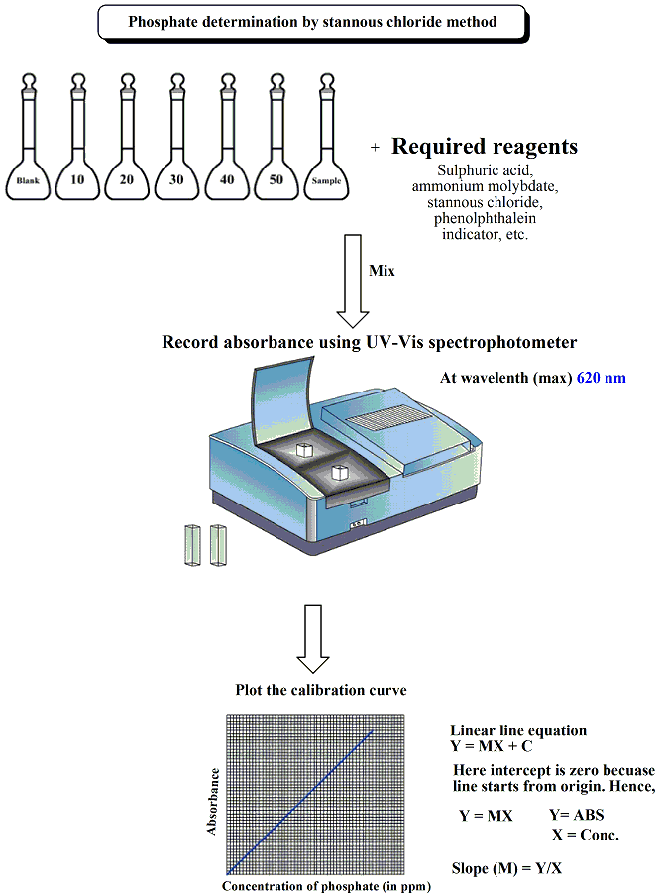
Procedure Chart
Result: Given water sample contain phosphate……………..ppm.

Slide 37
Lecture 6
Determination of dissolved oxygen by Winkler’s Method
Introduction: The term Dissolved Oxygen is used to describe the amount of oxygen dissolved in a unit volume of water. Dissolved oxygen (DO) is essential for the maintenance of healthy lakes and rivers. It is a measure of the ability of water to sustain aquatic life. In a healthy body of water such as a lake, river, or stream, the dissolved oxygen is about 8.0 ppm. The minimum DO level of 4 to 5 mg/L or ppm is desirable for survival of aquatic life.
Chemicals/Apparatus Required: Pipette, burette, glass bottles, glass rod, conical flask, reagent bottle, standard sodium thiosulphate solution (N/200), manganous sulphate (MnSO₄) solution, alkaline potassium iodide, freshly prepared starch solution, dilute sulphuric acid.
Theory: The concentration of oxygen dissolved in water is expressed in mg/L or as percentage saturation, where saturation is the maximum amount of oxygen that can theoretically be dissolved in water at a given altitude and temperature is called as dissolved oxygen (D.O.). Determination of dissolved oxygen is important for industrial purposes. Dissolved oxygen is needed for living organism to maintain their biological processes. D.O. is also important in precipitation and dissolution of inorganic substances in water. D.O. is an important factor as it causes corrosion in boilers and pipelines. Water usually contains about 8 mg of dissolved oxygen per liter at room temperature.

Slide 38
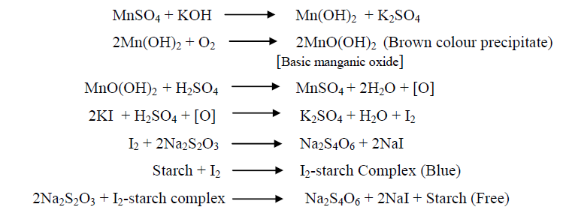
The Winkler’s method is mainly based on the Iodometric redox titration and is used to determine the level of dissolved oxygen in water sample and to estimate the biological activity in the water sample.
Reactions involved are:-
Procedure
A. Preparation of water sample (A)
1. Take 100 mL of tap water sample in 250 mL reagent bottle with the help of burette.
2. Add 10 mL mangnous sulphate solution, followed by 10 mL alkaline potassium iodide.
3. Cover the bottle with stopper, then shake and allow the precipitate (ppt) to settle.
4. Now, add 10 mL dilute sulphuric acid and mix until the ppt is completely dissolved.
5. Now, clear dark yellow colour solution will be obtained.

Slide 39
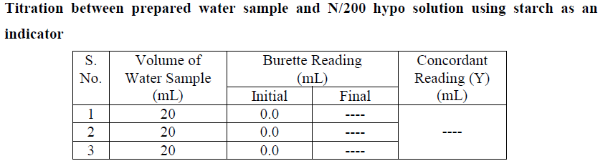
B. Titration of prepared sample (A)
6. Rinse and fill the burette with N/200 hypo solution up to mark.
7. Take 20 mL of above solution in 250 ml conical flask with the help of pipette.
8. Titrate the solution against N/200 hypo solution with the help of burette slowly until the colour of the solution become light yellow and then add about 2-3 drops of freshly prepared starch solution and again continue the titration till the disappearance of blue colour (blue to colourless).
9. Note the amount of hypo consumed (Y mL) and repeats the titration to obtain the concordant reading.
Observation Table

Slide 40
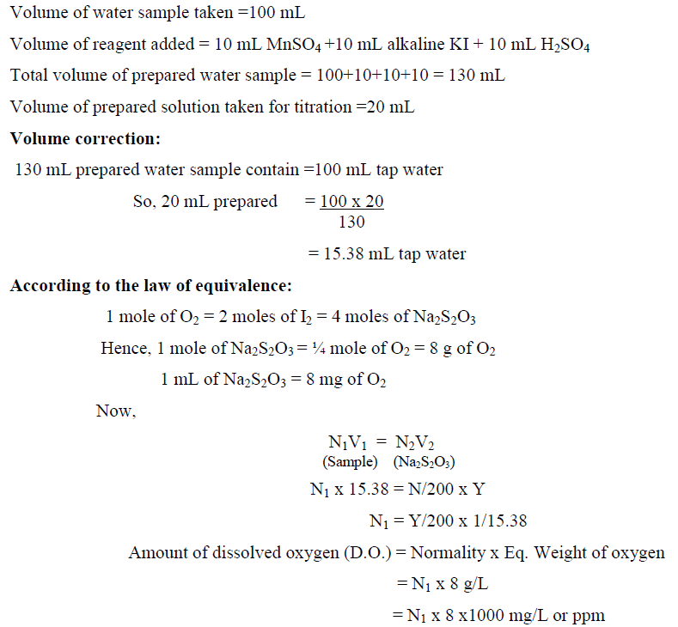
Calculations
Result: The dissolved oxygen content in given water sample is .........ppm.

Slide 41
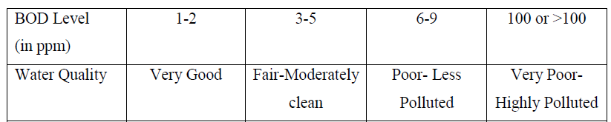
Lecture 7
Biochemical Oxygen Demand (BOD) and It’s Determination
Introduction: The amount of dissolved oxygen required by bacteria and other microorganisms for complete degradation/transformation of biodegradable organic waste under aerobic conditions is known as biochemical oxygen demand (BOD). It provides very valuable information regarding the purification capacity of streams and serves as a guideline for the regulatory authority to check the quality of effluents discharged into such water bodies.
It is a very important test for the analysis of sewage, industrial effluents, and grossly polluted water bodies. BOD is the best known assessing tool to measure the organic pollution of water. Thus, it is regarded as pollution indicator. A low BOD is an indicator of good quality water while a high BOD indicated high pollution level. BOD level for pure drinking water should be zero or less than 1 ppm. The BOD is usually expressed as mg/L or ppm.

Slide 42
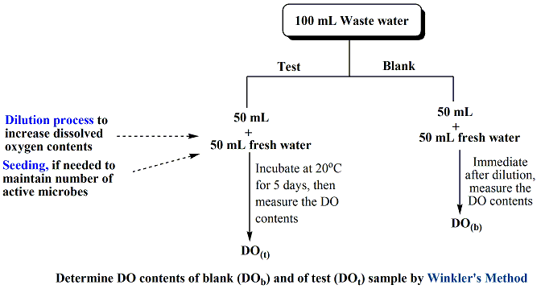
Theory/Principles
Degradation of organic wastes by microorganisms present in water sample requires oxygen for their proper growth as well as microbial activity. The BOD test essentially consists of measurement of dissolved oxygen (DO) contents of water sample before (referred as “Blank Sample”) and after (referred as “Test Sample”) incubation at 20ºC for 5days in dark. Incubation is the process of keeping something at the right temperature and under the right conditions so it can properly grown/develop. During measurement, if water sample does not have sufficient amount of oxygen, it is supplied by dilution process (in which fresh water containing sufficient oxygen contents is mix with sample water). If needed seeding process (if necessary, add the microbes externally) also incorporated during the measurement.
Procedure Chart

Slide 43
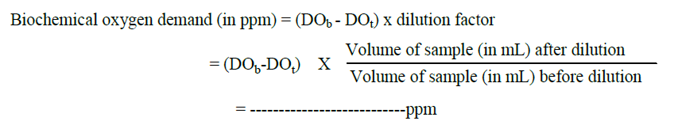
Calculations
BOD of sample may be calculated by using following equation:-
Result: BOD contents of given water sample………………..ppm.
Details about dissolved oxygen determination by Winkler’s method already discussed in Lecture 6

Slide 44
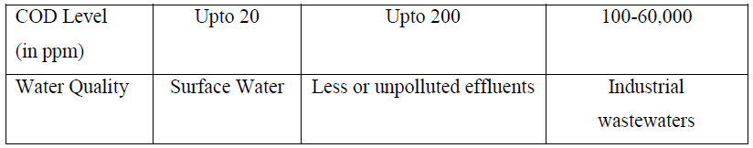
Chemical Oxygen Demand and It’s Determination
Introduction
The amount of oxygen equivalent required to oxidize all the oxidizable pollutants (organic and inorganic both) is known as chemical oxygen demand (COD). It is a measure of the amount of oxygen (or oxygen equivalent) to that portion of pollutants present in the water sample that is susceptible to oxidation by potassium dichromate. It is an important and quickly measured parameter for stream, sewage, and industrial waste samples to determine their pollution level.
It is a very important test for the analysis of sewage, industrial effluents, and grossly polluted water bodies. COD is the best known assessing tool to quick measure the pollution level of water containing organic as well as inorganic pollutants. It is also regarded as pollution indicator. A low COD is an indicator of good quality water while a high COD indicated high pollution level. COD level observed in surface water is about 20 ppm. As in the COD test, both the organic and inorganic matters are oxidized, hence the value of COD for a sample should be always greater than BOD value. It takes relatively less time compare to BOD. Industrial effluents generally do not respond to BOD test due to presence of toxic materials, in such cases COD is found to be very useful. The COD is expressed in mg/L or ppm.

Slide 45
Theory/Principles
The principle involved in the measurement of COD is that when the waste water sample is refluxed with a known excess amount of potassium dichromate (K₂Cr₂O₇) in a 50% H₂SO₄ solution in presence of AgSO₄ (which is acts as catalyst) and HgSO₄ (used to eliminate/reduce the interference caused due to presence of chloride), the oxidizable waste of the sample is oxidized to H₂O, CO₂ and NH₃. The excess dichromate remaining unreacted in the reaction mixture is titrated with standard solution of ferrous ammonium sulphate (FAS). The COD test essentially consists of measurement of oxygen equivalent contents of water sample before (referred as “Blank Sample”) and after (referred as “Test Sample”) refluxing (heating using water bath) at 100ºC for 1-3 hours.

Slide 46
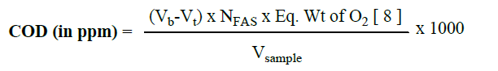
Procedure Chart
Calculations
BOD may be calculated by using following equation-
Where V_{b} and V_{t} are the volumes of ferrous ammonium sulphate of normality N, run down in the Blank and Test experiments, respectively and V_{sample} is the volume of sample taken for the test.
Result: COD contents of given water sample………………..ppm.

Slide 47
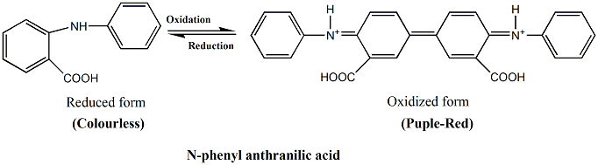

Dichrometry method to determine strength of unreacted dichromate: Dichrometry method to determine the strength of unreacted dichromate contents of water sample is based on redox titration where K₂Cr₂O₇ used as oxidizing agent, ferrous ammonium sulphate used as reducing agent, and N-phenyl anthranilic acid used as an indicator.
Reagents Required: Refluxing apparatus, water bath, burette, pipette, conical flask, standard ferrous ammonium sulphate, AgSO₄, HgSO₄, sulphuric acid, N-phenyl anthranilic acid indicator.
Indicator: N-phenyl anthranilic acid indicator
Colour Change: Purple Red → Colourless
Reactions involved: The reaction between potassium dichromate and ferrous ammonium sulphate are -

Slide 48

Procedure

Slide 49

Lecture 8
UV-Vis. Spectroscopy
Introduction
When a beam of electromagnetic radiations (Ultra violet or visible) is passed through a compound, certain radiations (or wavelengths) are absorbed by the substance. There is some energy associated with every radiation (E= hv, where h is the Planck’s constant and v is the frequency of radiation.)

Slide 50
Absorption Laws: Spectroscopy works on the laws governing absorption of light by a substance. Two major laws which govern the absorption of light are given below:
Thus, Lambert-Beer’s Law is A = ε.c.l

Slide 51


Principle: Molecules containing bonding and non-bonding electrons (n-electrons) can absorb energy in the form of ultraviolet or visible light to excite these electrons to higher anti-bonding molecular orbitals. The more easily excited the electrons (i.e. lower energy gap between the highest occupied molecular orbital (HOMO) and the lowest unoccupied molecular orbital (LUMO), the longer the wavelength of light it can absorb. There are four possible types of transitions (π–π*, n–π*, σ–σ*, and n–σ*), and they can be ordered as follows :σ–σ* > n–σ* > π–π* > n–π*.
UV-Vis. Spectrophotometer: It records the spectra of compounds in the range of 200-800 nm. This range consists of two parts, 200-400 nm is the range of ultraviolet (UV) whereas 400-800 nm is the range of visible light. A schematic representation of single-beam spectrophotometer (a) and double-beam spectrophotometer (b) are given below:-
(a) Single-beam UV-Vis. Spectrophotometer
(b) Double-beam UV-Vis. Spectrophotometer

Slide 52



Instrumentation

Slide 53


Slide 54


# Way a spectrophotometer measure the sample
# A typical UV-Vis. Spectrum

Slide 55
Working Procedure
A. Calibrate the Spectrometer
Turn on the UV-Vis spectrometer and allow the lamps to warm up for an appropriate period of time (around 20 min) to stabilize them.
Fill a cuvette with the solvent for the sample and make sure the outside is clean. This will serve as a blank and help account for light losses due to scattering or absorption by the solvent.
Place the cuvette in the spectrometer. Make sure to align the cuvette properly, as often the cuvette has two sides, which are meant for handling (may be grooved) and are not meant to shine light through.
Take a reading for the blank. The absorbance should be minimal, but any absorbance should be subtracted out from future samples. Some instruments might store the blank data and perform the subtraction automatically (Double-beam spectrophotometer).

Slide 56
B. Perform an Absorbance Spectrum
Fill the cuvette with the sample. To make sure the transfer is quantitative, rinse the cuvette twice with the sample and then fill it about ¾ full. Make sure the outside is clean of any fingerprints, etc.
Place the cuvette in the spectrometer in the correct direction.
Cover the cuvette to prevent any ambient light.
Collect an absorbance spectrum by allowing the instrument to scan through different wavelengths and collect the absorbance. The wavelength range can be set with information about the specific sample, but a range of 200–800 nm is standard. A diode-array instrument is able to collect an entire absorbance spectrum in one run.
From the collected absorbance spectrum, determine the absorbance maximum (λ_{max}). Repeat the collection of spectra to get an estimate of error in λ_{max}.
To make a calibration curve, collect the UV-Vis spectrum of a variety of different concentration samples. Spectrometers are often limited in linear range and will not be able to measure an absorbance value greater than 1.5. If the absorbance values for the sample are outside the instrument's linear range, dilute the sample to get the values within the linear range.

Slide 57


Applications of UV-Vis. Spectroscopy

Slide 58
Calibration: Spectrophotometer needs to be calibrated against a blank solution so that measurements after it can use the blank solution's absorbance as a zero reference.
Traceability is the capability to trace something. Traceability ensures equivalent measurements are made regardless of the instrument or the region of the world where the measurement is made.

Slide 59

Lecture 9
Atomic Absorption Spectroscopy (AAS)
Introduction: Atomic absorption spectroscopy (AAS) is a spectro-analytical procedure for the quantitative determination of chemical elements using the absorption of optical radiation (light) by free atoms in the gaseous state.
Atomic absorption spectrometry (AAS) is a technique in which free gaseous atoms absorb electromagnetic radiation at a specific wavelength to produce a measurable signal. The absorption signal is proportional to the concentration of those free absorbing atoms in the optical path. Therefore, for AAS measurements the analyte must be first converted into gaseous atoms, usually by application of heat to a cell called atomizer. It was first introduced in 1955 by Walsh and this technique revolutionized the field of trace element analyses. AAS is a popular technique because it is fairly fast and straightforward and the instrumentation is affordable.

Slide 60
Principle
The absorption of energy by ground state atoms in the gaseous state forms the base of AAS. When a solution containing metallic species is introduced into a flame, the vapour of metallic species will be obtained. Some of the metal atoms may be raised to an energy level sufficiently high to emit the characteristics radiation of the metal-a phenomenon that is utilized in the familiar technique of emission flame photometry. But, a large percentage of the metal atoms will remain in the ground state. These ground state atoms of a particular elements are receptive of light radiation of their own specific resonance wavelength (in general, the same wavelength as they would emit if excited). Thus, when a light of this wavelength is allowed to pass through a flame having atoms of the metallic species, the part of that light will be absorbed and the absorption will be proportional to the density/concentration of the atoms in the flame. Thus, by using AAS one can determine concentration of metallic elements quantitatively at very small concentration level (trace).

Slide 61

Instrumentation
Schematic diagram of AAS

Slide 62

1 Source of Light
Hollow Cathode Lamp
Hollow-cathode lamps contain a cathode of the analyte element and an anode, and are filled with a noble gas. There is a glow discharge between the cathode and the anode, in which positive gas ions are formed, which sputter element atoms of the cathode at relatively low temperatures. These lamps emit mostly lines excited from the ground state and show only slight line broadening.

Slide 63


Slide 64


Some of the most common and widely used fuel-oxidant combinations are given as:-
4 Nebulization: Before the liquid sample enters the burner, it is first of all converted into small droplets. The formation of small liquid droplets from liquid sample is called nebulization.

Slide 65

8 Read-Out Device: In most of the AAS measurements, chart recorders (a potentiometer) are used as read-out devices. Other one used digital read-out devices.

Slide 66

Working of AAS
Applications: Used in both the qualitative and quantitative measurements of metallic elements (in traces) from various environmental and biological samples.

Slide 67
Lecture 10
Nephelometry and Turbidimetry
This is mainly used to determine the scattering of the light by the suspended particles present in the sample solution. The instruments used for the measurement of the scattering are called nephelometer and turbidimeter. The choice between the nephelometry and turbidimetry depends upon the fraction of light scattered.
It’s working mainly based on how a turbidity producing particle affect the transmission and scattering of light. Turbidity in a liquid is caused by the presence of finely divided suspended particles. If a beam of light is passed through a turbid sample, its intensity is reduced by scattering and the quantity of light scattered is dependent upon the concentration and size distribution of the particles. Nephelometry and turbidimetry are used in the determination of suspended material/particles in environmental and biological samples. The most widely used measurement unit for turbidity is the Formazin Turbidity Unit (FTU). ISO refers to its units as FNU (Formazin Nephelometric Unit).

Slide 68

Turbidimetry: Turbidimetry is the measurement of the transmitted light (at 180º) by the suspended particles to the incident beam. This is used for the determination of the high concentration suspensions. The basis of turbidimetric analysis is the measurement of the intensity of transmitted light as a function of the cone of the suspended particles.
Nephelometry: Nephelometry is the measurement of the scattered light by the suspended particles at right angles (at 90º) to the incident beam. This method is mainly used for the determination of the low concentration suspensions. In nephelometry, the basic principle involved is the measurement of the intensity of the scattered light as a function of the concentration of the dispensed phase.

Slide 69
Light scattering is the physical character of the light which will depend on the following factors:
1. Concentration of suspending materials
2. Particle size & geometry: In both turbidimetric and nephelometric analyses, the most critical factor is the control of particle size and shape. One should prepare samples and standards under identical conditions. The conditions include concentration of reactants, temperature, agitation, pH, the presence of non-reactants and order of mixing of reactants.
3. Wavelength of incident light: The general practice is to select such a wavelength where the sample solution does not absorb strongly.
4. Refractive index difference between the particles and it’s surrounding medium: Best results are obtained when there is an appreciable RI difference between the particle and its surroundings medium.

Slide 70
Turbidimetry | Nephelometry
In turbidimetry, one measures the transmitted of a primary beam of radiation which is defined as follows: S = log I₀/I = kbc where I₀ is the intensity of incident light; I is the intensity of light after passing through the sample; S is the turbidence; b is the path length; k is the proportionality constant; c is the concentration of the sample | In nephelometry, the scattered light intensity depends upon a number of factors such as properties of scattering suspension, angle and geometry of the measuring instrument. Is = k_{s}I₀c where k_{S} is the empirical constant; c is the concentration of suspended particles; I_{S} is the scattered of light intensity; I₀ is the intensity of incident light.
I_{s}/I_{o}
S
Conc.
Conc.

Slide 71

Instrumentation
Instrumentation used in nephelometry and turbidimetry is very similar to spectrophotometer devices.
Sources:
Mercury is lamp: Under light pressure, the excitation of mercury atoms is done by electric discharge.
Tungsten lamp: It contains a piece of tungsten wire which is heated in a controlled atmosphere.
Filters: Filters will convert the polychromatic light to monochromatic light. Generally filters are used for this purpose. Fitters are of two types:
Absorption filters
Interference filters
Sample cells: In general, a cell with a rectangular cross-section is preferred, where measurements are to be made at angles other than 90°. Semi-octagonal cells are widely used.

Slide 72

Detectors: Most commonly used detectors in the nephelometry and turbidimetry are photomultiplier tubes. In order to obtain greater sensitivity to very weak light intensities, multiplication of the initial photo-electrons by secondary emission is employed. Several anodes at a gradually increasing potential are contained in one bulb.

Slide 73


Turbidimeter: In most turbidimeter, ordinary calorimeters (or) spectrophotometers may be used.
Nephelometer: The photo-multiplier tube detector is used as a receiver which is mounted on a turnable and may be positioned at any desired angles from 0° to 180° relative to the exit beam.

Slide 74
APPLICATIONS OF NEPHLOMETRY AND TURBIDIMETRY
Used in the analysis of water for purity and for the detection of the impurities.
Used in the determination of CO₂.
Phosphorus can be estimated as a concentration of 1 part in more than 300 million parts of water as a precipitate with strychnine molybdate reagent (mainly used in water treatment plants).
Used in the determination of turbidity in the sugar products.
Used in the determination of clarity of citrus juices.
Used in the determination of benzene percentage in alcohol.
Used in the determination of amount of amino acids, vitamins and antibiotics.
Used in the determination of protein.
Used in the monitoring of the air and water pollution.
Used in turbidimetric titrations: absorbance versus volume of titrant added is plotted.

